Slide 1
Java EE - Security
Ari M. Ayvazyan, Adrian W. Bergler

Slide 2
Agenda
Principles of Secure Systems
Introduction to Security Architecture
Authentication & Authorization
Deployment Descriptors
Realms, Roles, Principals, Groups
Live example
Enterprise Beans
Frameworks
Output escaping
Summary & Questions

Slide 3
Secure Systems
CIA-Triad
Confidentiality
Integrity
Availability
Non-Repudiation

Slide 4
Confidentiality
Data can‘t be read by unauthorized

Slide 5
Integrity
State of system can‘t be modified by unauthorized

Slide 6
Availability
How stable the system is against errors and attacks
Being available in general

Slide 7
Non-Repudiation
Actions only be executed by their defined identities (eg. user groups)
Also: Ability to make users accountable for their actions

Slide 8
Introduction
Transport Layers
Transport Security - VPN
Java EE
Users, Logins, Permissions
SQL
SQL Users & Permissions
Https
Java EE
Output Escaping

Slide 9
Possible Security Implementations
Declarative Security (this includes @Annotations and XML-Files)
applied by the container during deployment.
Programmatic Security
applied by itself at runtime.

Slide 10
Authentication & Authorization
Authentication
Who are you?
Identification
Authorization
What are you allowed to do?
Assignment of Permissions to a Authenticated User

Slide 11
Deployment Descriptors
Describes how the Application should be Deployed.
Defines Security Constraints
Protected Information
Probably SSL
Specify which user may access them
XML-Files
Usually located in /WEB-INF/
web.xml
Vendor-specific.xml (E.g. Glassfish: glassfish-web.xml)

Slide 12
Deployment Descriptors web.xml
Protected Resources
Security Roles
Authentication methods

Slide 13
Deployment Descriptors (vendor-specific).xml
User – Role mapping
Group – Role mapping
Vendor specific settings of a container

Slide 14
Principals, Credential
A Principal is a identity that can be authenticated.
E.g. a Unique Username
A Credential is defined as information that is used to authenticate a Principal.
E.g. a Password

Slide 15
Groups, Roles
Permissions are granted to Roles.
Groups and Principals can be mapped to Roles.
Roles are defined in web.xml
Groups are defined in vendor-specific.xml

Slide 16
Realm
Provides information about principals, their Groups and their credentials
May be a Database, File structure, connection…
In other words
Contains User Information
E.g. Username, Password & Permissions

Slide 17

Live example preview
GET …/primes/ HTTP/1.1
Request
---
---
---
Server
Response
Browser
HTTP/1.1 401 Unauthorized

Slide 18

Live example preview
GET …/primes/ HTTP/1.1
AUTORIZATION DATA
Request
---
---
---
Server
Response
Browser
HTTP/1.1 200 OK

Slide 19
Live example
https://github.com/aayvazyan-tgm/JavaEESecurityExample

Slide 20
Enterprise Java Beans
Role-based authentication
Limit access to certain roles
Beans (whole class)
Methods independent of their signature
Methods with definition of their signature

Slide 21
Enterprise Java Beans
Declarative
Through deployment descriptor
Annotations
Programmatic
Directly in source code

Slide 22
Declarative
web.xml
Method permissions
<assembly-descriptor>
Altered identity within security context
<security-identity>

Slide 23
Annotations
Within Beans
@Declare Roles
@RolesAllowed
@PermitAll
@DenyAll

Slide 24
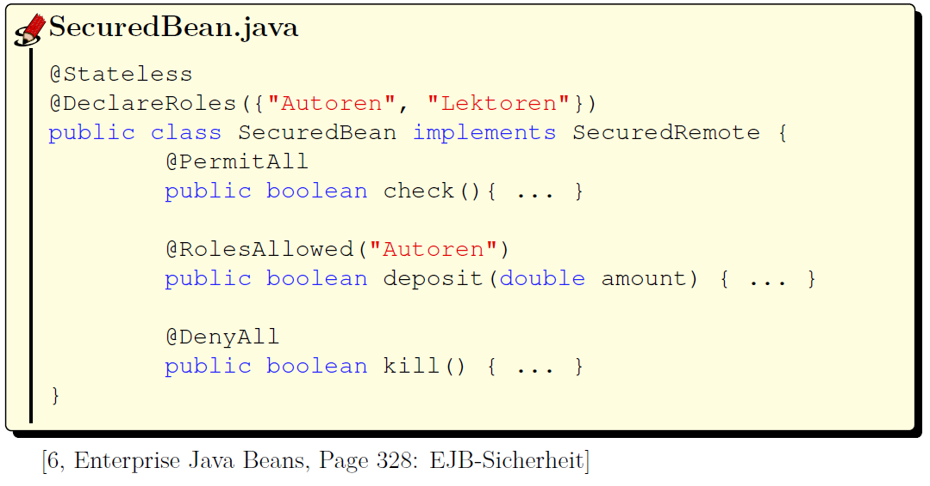

Slide 25
Programmatic
Directly in Source-Code
Within methods of a Bean
Via EntityContext-Object
.getCallerPrincipal()
Returns current principal
Principle-Object: .isCallerInRole(<param>)
Returns if the principle is within a certain Role

Slide 26
Application Clients
Security Concerns
Malware
Decompiling
Disassembling
Custom Clients
Be careful with „trusting“ the client.

Slide 27
Securing Application Clients
Same authentication requirements as other JEE Components
Authentication methods are the same as well:
HTTP basic authentication
HTTP login-form authentication
SSL client authentication

Slide 28
Login
Programmatic
EJB Client: ProgrammaticLogin-Class and it‘s methods
Server-specific!
Frameworks!
Login Modules
Via Java Authentication and Authorization Service (JAAS)

Slide 29
Digital Certificates
Server Authorization
Sometimes the server‘s identity is important
Client Certificates
Self-Authentication
Secure communication
HTTPS
SSL

Slide 30
Digital Certificates
Signed by Certificate Authority
Sometimes identity is very important
E.g. e-commerce
Create a Certificate
Let it get signed by a Certificate Authority (CA)
VeriSign
Thawte

Slide 31
Digital Certificates
Self-Signed
Sometimes identity is not that important
But: Secure communication is still required
In this case:
Create a Certificate
Sign it yourself

Slide 32
Digital Certificates keytool
Strong tool that ships with the SDK
Can be used for certificate creation and signing
Administration of Public/private keys in general
Also: Client certificates

Slide 33
Frameworks … - Advantages
are tested
are more secure due to public testing
are supported
can save time on long term

Slide 34
Frameworks … - Disadvantages
need to be learned
can be limited in the possibilities
need to be trusted

Slide 35
Frameworks
Provide: Authentication, Authorization, Cryptography
Apache Shiro
Simple Code Structure
Not bound to HTTP
Spring Security
Very structured
JAAS - Java Authentication and Authorization Service
Included in Java SE since Java 1.4 (javax.security.auth)

Slide 36
Shiro Example
https://github.com/aayvazyan-tgm/JavaEESecurityExample

Slide 37
Output escaping
Escape user input
To prevent injections
Escape the output
To add an extra layer of security (for the user)
Do not show Stack traces
Use a Framework!

Slide 38
Sources
JavaOne 2014: The Anatomy of a Secure Web Application Using Java, Shawn McKinney & John Field, September 29, 2014 San Francisco
Java Security: Sicherheitslücken identifizieren und vermeiden, Marc Schönefeld, 1. edition 2011 Publisher: Hüthig Jehle Rehm GmbH, Heidelberg. ISBN/ISSN 978-3-8266-9105-8
Enterprise Java Security: Building Secure J2EE Applications, Marco Pistoia, Natara j Nagaratnam, Larry Koved, Anthony Nadalin, 1. edition 2004 Publisher: Addison-Wesley Professional. ISBN/ISSN: I SBN 0-321-11889-8
Official JavaEE Documentation, Oracle, 29.09.2014 http://do cs.oracle.com/javaee/7/tutorial/do c/security-intro.htm
Java EE 6, Dirk Weil, 1. edition 2012 Publisher: entwickler.press ISBN 978-3-86802-077-9
Java EE 6 Cookbook for Securing, Tuning, and Extending Enterprise Applications, Mick Knutson, 1. edition June 2012 Publisher: Addison-Wesley Professional. ISBN/ISSN: I SBN 9781849683166

Slide 39
Questions?

